Slide 1
SI 671 Discussion 0
Introduction to Data Science and Linear Algebra

Slide 2
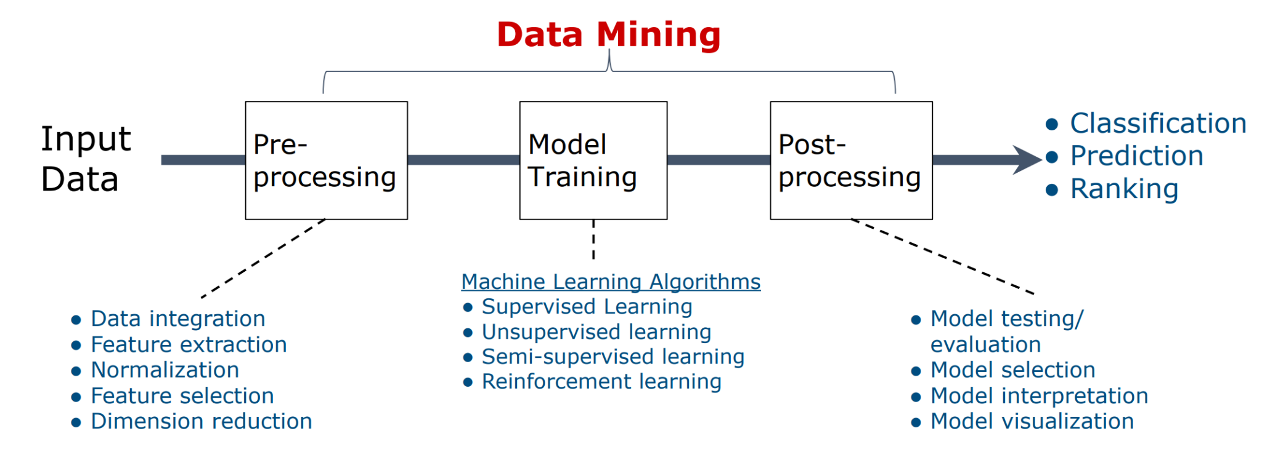
Course Overview
Data: focus on properties, structure information, and values.
Knowledge: pattern, similarity, association, classification, clustering, prediction, …
Techniques: machine learning, statistics, user modeling, …
Applications: advertising, spam call detection, …

Slide 3

Data Manipulation with Pandas
Basic statistics
Data transformation
Selection
Sorting
Aggregation
One-hot encoding
Merge/join dataframe
Iris flower dataset
[1] From Wikipedia: Iris flower dataset is a multivariate data set to quantify the morphological variation of Iris flowers of three related species.
Notes:
Pandas: API reference — pandas 2.0.3 documentation (pydata.org)
Sorting: pandas.DataFrame.sort_values — pandas 2.0.3 documentation (pydata.org)
Aggregation: pandas.DataFrame.agg — pandas 2.0.3 documentation (pydata.org)
One-hot encoding: pandas.get_dummies — pandas 2.0.3 documentation (pydata.org)
Merge: pandas.DataFrame.merge — pandas 2.0.3 documentation (pydata.org)
Join: pandas.DataFrame.join — pandas 2.0.3 documentation (pydata.org)

Slide 4
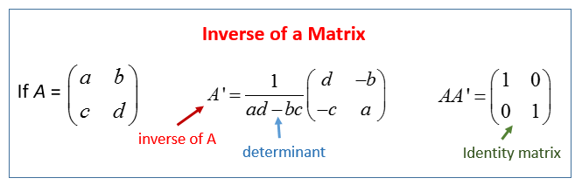
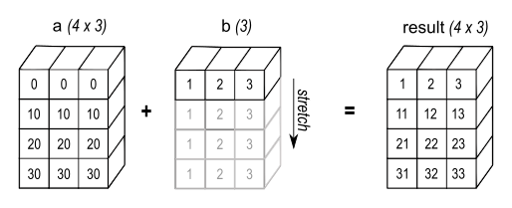
Matrix Manipulation with Numpy
Shape
Transpose
Mathematical operations (sum, mean, max, etc.)
Matrix addition
Element-wise multiplication
Matrix multiplication
Inverse matrix:
https://www.mathsisfun.com/algebra/matrix-inverse.html
Broadcasting:
https://numpy.org/doc/stable/user/basics.broadcasting.html

Slide 5
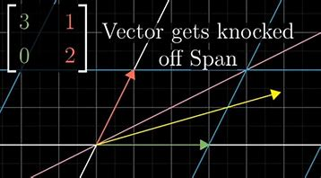
Linear Algebra
Eigenvalues & Eigenvectors:
If A is a linear transformation from a vector space V over a field F into itself and v is a nonzero vector in V, then v is an eigenvector of A if Av is a scalar multiple of v.
Av = λv,
where A is a square matrix and λ is a scalar in F.

Slide 6
Linear Algebra
Why do matrices have to be square?
Hint: the matrix multiplication of A, a m-by-n matrix, represents a map from a n-dimensional space to a m-dimensional space.

Slide 7
Linear Algebra
Imagine, we know A is of size m*n , then let's explore our definition:
Av = λv.
Eigenvectors describe the column space of A, so we have n of them.
Consider the shape:
[m * n] @ [n * n] = [?] * [n * n].
From the right side we have scalar multiplication, not a matrix product.
So what number must [?] be?
From the basics we know we can only multiply n scalars by n rows, to produce a n*n matrix.
Ans: [?] must be of size n.
And if this is true, then the left side, m must actually be n, namely
m = n.

Slide 8
Linear Algebra
Singular Value Decomposition (SVD):
It generalizes the eigen-decomposition of a square matrix with an orthonormal eigenbasis to any m * n matrix.
M = UΣV^{T},
where the linear transformation is decomposed into two rotations and one scaling.
U: the left singular vectors
V: the right singular vectors
and the singular values common to both U and V, in a diagonal matrix Σ.

Slide 9
Linear Algebra
Principal Component Analysis (PCA):
PCA is a statistical technique for reducing the dimensionality of a dataset. After transformation, (most of) the variation in the data can be described with fewer dimensions than the initial data.
Principal components are new variables that are combinations of the initial variables and that depicts the maximum amount of variance. They are eigenvectors of the covariance matrix. Thus, the principal components are often computed by eigen-decomposition of the data covariance matrix or singular value decomposition of the data matrix.
Intention: reduce the dimension due to computational limitations; restore the most useful information (variance); denoise.
[2] PCA explained variance. https://ro-che.info/articles/2017-12-11-pca-explained-variance.

Slide 10
Linear Algebra
Principal Component Analysis (PCA):

Slide 11
Linear Algebra
How to choose the optimal number of principal components k?
Choose manually: If you theoretically expect an underlying dimension of the dataset, like there were 3 factors that created a process, then this could be a choice.
Scree plot: This can be somewhat subjective but it is simple. Pick a cumulative variance cutoff point.
Cross-validate: If used in a predictive task, treat as a tuning/hyperparameter
PCA vs. SVD: Comparing PCA and SVD, they are similar in that they both work on non-square and square matrices and make use of eigenvalues. However, PCA is different from SVD in that it does not work on the original matrix. Instead, it works on the covariance matrix. SVD is unique, while PCA is not.

